Slide 1
Collections in Java
Java Collection means a single unit of objects. Java Collection framework provides many interfaces (Set, List, Queue, Deque) and classes (ArrayList, Vector, LinkedList, PriorityQueue, HashSet, LinkedHashSet, TreeSet).
What is Collection in Java
A Collection represents a single unit of objects, i.e., a group.

Slide 2
Java Collections Framework
Introduction,
The Arrays Class,
Searching and sorting arrays of primitive data types,
Sorting Arrays of Objects,
The Comparable and Comparator Interfaces, Sorting using Comparable & Comparator,
Collections: Lists, Sets, Maps, Trees, Iterators and Collections, The Collection Class.

Slide 3
What is a framework in Java
It provides readymade architecture.
It represents a set of classes and interfaces.
It is optional.

Slide 4
What is Collection framework
The Collection framework represents a unified architecture for storing and manipulating a group of objects. It has:
Interfaces and its implementations, i.e., classes
Algorithm

Slide 5
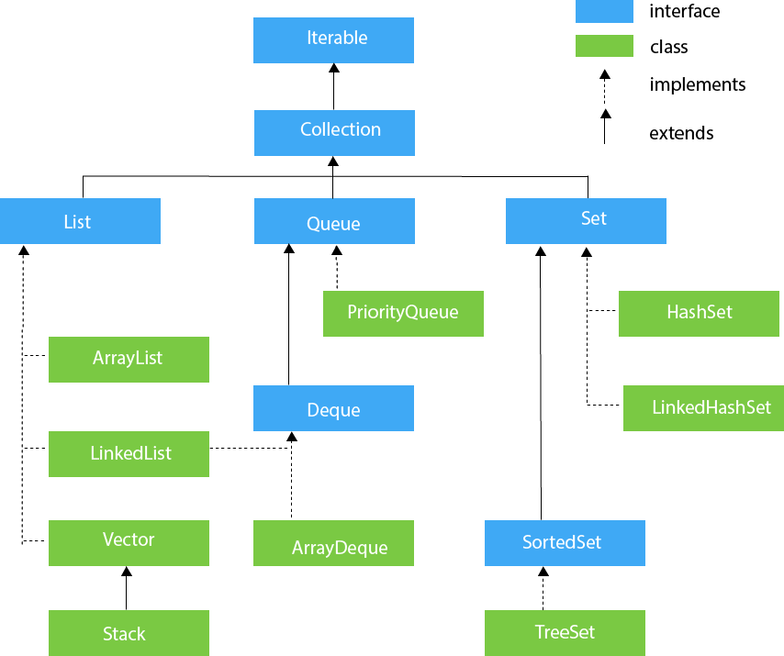

Slide 6
Array Classes
Array collection of is similar data type
Arrays<method_name>;

Slide 7
Comparable and Comparator
Comparable and Comparator both are interfaces and can be used to sort collection elements.

Slide 8
Comparable
1) Comparable provides a single sorting sequence. In other words, we can sort the collection on the basis of a single element such as id, name, and price.
2) Comparable affects the original class, i.e., the actual class is modified. Comparator doesn't affect the original class, i.e., the actual class is not modified.
3) Comparable provides compareTo() method to sort elements.
4) Comparable is present in java.lang package.
5) We can sort the list elements of Comparable type by Collections.sort(List) method.
Comparator
1)The Comparator provides multiple sorting sequences. In other words, we can sort the collection on the basis of multiple elements such as id, name, and price etc.
2)Comparator doesn't affect the original class, i.e., the actual class is not modified.
3)Comparator provides compare() method to sort elements.
4) A Comparator is present in the java.util package.
5)We can sort the list elements of Comparator type by Collections.sort(List, Comparator) method.

Slide 9
Sorting with Comparable and Comparator in Java
Programmers frequently need to sort elements from a database into a collection, array, or map. In Java, we can implement whatever sorting algorithm we want with any type. Using the Comparable interface and compareTo() method, we can sort using alphabetical order, String length, reverse alphabetical order, or numbers. The Comparator interface allows us to do the same but in a more flexible way.
Whatever we want to do, we just need to know how to implement the correct sort logic for the given interface and type.
Get the source code
Get the code for this Java Challenger. You can run your own tests while you follow the examples.

Slide 10
class Simpson implements Comparable<Simpson> {
String name;
Simpson(String name) {
this.name = name;
}
@Override
public int compareTo(Simpson simpson) {
return this.name.compareTo(simpson.name);
}
}
public class SimpsonSorting {
public static void main(String... sortingWithList) {
List<SimpsonCharacter> simpsons = new ArrayList<>();
simpsons.add(new SimpsonCharacter("Homer "));
simpsons.add(new SimpsonCharacter("Marge "));
simpsons.add(new SimpsonCharacter("Bart "));
simpsons.add(new SimpsonCharacter("Lisa "));
Collections.sort(simpsons);
simpsons.stream().map(s -> s.name).forEach(System.out::print);
Collections.reverse(simpsons);
simpsons.stream().forEach(System.out::print);
}
}

Slide 11
ArrayList
ArrayList
ArrayList is a class present in java. util package.
It provides a dynamic array for storing the element.
It is an array but there is no size limit.
We can add or remove elements easily.
It is more flexible than a traditional array.

Slide 12
How to create ArrayList
This is way is to store values of the same datatype
import java.util.*;
class Demo11
{
public static void main(String[] args)
{
ArrayList< String> al = new ArrayList< String>();
al.add("ab");
al.add("bc");
al.add("cd");
System.out.println(al);
}
}

Slide 13
LinkedList class
Java LinkedList class provides implementation of linked-list data structure. It used doubly linked list to store the elements.
LinkedList class extends AbstractSequentialList and implements List,Deque and Queue inteface.
It can be used as List, stack or Queue as it implements all the related interfaces.
It is dynamic in nature i.e it allocates memory when required. Therefore insertion and deletion operations can be easily implemented.
It can contain duplicate elements and it is not synchronized.
Reverse Traversing is difficult in linked list.
In LinkedList, manipulation is fast because no shifting needs to be occurred.

Slide 14
LinkedList class Example Lets take an example to create a linked-list and add elements using add and other methods as well. See the below example.
import java.util.* ;
class Demo
{
public static void main(String[] args)
{
LinkedList< String> ll = new LinkedList< String>();
ll.add("a");
ll.add("b");
ll.add("c");
ll.addLast("z");
ll.addFirst("A");
System.out.println(ll);
}
}

Slide 15
Some of the methods in the linked list are listed below:
Method Description
boolean add( Object o) It is used to append the specified element to the end of the vector.
boolean contains(Object o) Returns true if this list contains the specified element.
void add (int index, Object element) Inserts the element at the specified element in the vector.
void addFirst(Object o) It is used to insert the given element at the beginning.
void addLast(Object o) It is used to append the given element to the end.
int size() It is used to return the number of elements in a list
boolean remove(Object o) Removes the first occurrence of the specified element from this list.
int indexOf(Object element) Returns the index of the first occurrence of the specified element in this list, or -1.
int lastIndexOf(Object element) Returns the index of the last occurrence of the specified element in this list, or -1.

Slide 16
Vector
Vectors : Vectors are similar to arrays, where the elements of the vector object can be accessed via an index into the vector. Vector implements a dynamic array. Also, the vector is not limited to a specific size, it can shrink or grow automatically whenever required. It is similar to ArrayList, but with two differences :
Vector is synchronized.
Vector contains many legacy methods that are not part of the collections framework.

Slide 17
mport java.util.*;
public class VectorExample1 {
public static void main(String args[]) {
//Create an empty vector with initial capacity 4
Vector<String> vec = new Vector<String>(4);
//Adding elements to a vector
vec.add("Tiger");
vec.add("Lion");
vec.add("Dog");
vec.add("Elephant");
//Check size and capacity
System.out.println("Size is: "+vec.size());
System.out.println("Default capacity is: "+vec.capacity());
//Display Vector elements
System.out.println("Vector element is: "+vec);
vec.addElement("Rat");
vec.addElement("Cat");
vec.addElement("Deer");
//Again check size and capacity after two insertions
System.out.println("Size after addition: "+vec.size());
System.out.println("Capacity after addition is: "+vec.capacity());
//Display Vector elements again
System.out.println("Elements are: "+vec);
//Checking if Tiger is present or not in this vector
if(vec.contains("Tiger"))
{
System.out.println("Tiger is present at the index " +vec.indexOf("Tiger"));
}
else
{
System.out.println("Tiger is not present in the list.");
}
//Get the first element
System.out.println("The first animal of the vector is = "+vec.firstElement());
//Get the last element
System.out.println("The last animal of the vector is = "+vec.lastElement());
}
}

Slide 18
Stack
Stack is one of the sub-class of Vector class so that all the methods of Vector are inherited into Stack.
The concept of Stack of Data Structure is implemented in java and develop a pre-defined class called Stack.
stack

Slide 19
Syntax
Stack s=new Stack();
Constructors of Stack
Stack(): is used for creating an object of Stack.
Syntax
Stack s=new Stack();

Slide 20
Methods of Stack
public boolean empty(): is used for returns true provided Stack is empty.It returns false in case of Stack is non-empty.
public void push (Object): is used for inserting the elements into the Stack.
public Object pop(): is used for removing Top Most elements from the Stack.
public Object peek(): is used for retrieving Top Most element from the Stack.
public int search(Object): is used for searching an element in the Stack.If the element is found then it returns Stack relative position of that element otherwise it returns -1, -1 indicates search is unsuccessful and element is not found.

Slide 21
mport java.util.*;
class StackDemo
{
public static void main(String args[])
{
Stack s=new Stack();
System.out.println("content of s="+s); //[]
System.out.println("size of s="+s.size()); //10
System.out.println("Is empty?="s.empty()); //true
//add the data to s
s.push(10);
s.push(20);
s.push(30);
s.push(40);
System.out.println("content of s="+s); //[10,20,30,40]
System.out.println("size of s="+s.size()); //4
System.out.println("Is s empty ?=s.empty()"); //false
//remove the top most element
System.out.println("delete element="+s.pop()); //40
System.out.println("content of s after pop="+s);// [10,20,30]
//extract the top most element
System.out.println("top most element="+s.peek()); //30
System.out.println("content of s after peek="+s); //[10 20 30]
//Search the element 10 and 100
int srp=s.search(10);
System.out.println("stack relative pos.of 10 is="+srp); //3
int srp1=s.search(100);
System.out.println("stack relative pos.of 100 is="+srp1); //-1
}
}

Slide 22
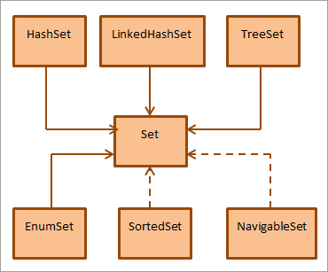
Sets

Slide 23
Set
The set is an interface available in the java.util package. The set interface extends the Collection interface. An unordered collection or list in which duplicates are not allowed is referred to as a collection interface. The set interface is used to create the mathematical set. The set interface use collection interface's methods to avoid the insertion of the same elements. SortedSet and NavigableSet are two interfaces that extend the set implementation.

Slide 24
import java.util.*;
public class SetOperations
{
public static void main(String args[])
{
Integer[] A = {22, 45,33, 66, 55, 34, 77};
Integer[] B = {33, 2, 83, 45, 3, 12, 55};
Set<Integer> set1 = new HashSet<Integer>();
set1.addAll(Arrays.asList(A));
Set<Integer> set2 = new HashSet<Integer>();
set2.addAll(Arrays.asList(B));
// Finding Union of set1 and set2
Set<Integer> union_data = new HashSet<Integer>(set1);
union_data.addAll(set2);
System.out.print("Union of set1 and set2 is:");
System.out.println(union_data);
// Finding Intersection of set1 and set2
Set<Integer> intersection_data = new HashSet<Integer>(set1);
intersection_data.retainAll(set2);
System.out.print("Intersection of set1 and set2 is:");
System.out.println(intersection_data);
// Finding Difference of set1 and set2
Set<Integer> difference_data = new HashSet<Integer>(set1);
difference_data.removeAll(set2);
System.out.print("Difference of set1 and set2 is:");
System.out.println(difference_data);
}
}

Slide 25
HashSet
Java HashSet class hierarchy
Java HashSet class is used to create a collection that uses a hash table for storage. It inherits the AbstractSet class and implements Set interface.
The important points about Java HashSet class are:
HashSet stores the elements by using a mechanism called hashing.
HashSet contains unique elements only.
HashSet allows null value.
HashSet class is non synchronized.
HashSet doesn't maintain the insertion order. Here, elements are inserted on the basis of their hashcode.
HashSet is the best approach for search operations.

Slide 26
import java.util.*;
class HashSet2{
public static void main(String args[]){
//Creating HashSet and adding elements
HashSet<String> set=new HashSet<String>();
set.add("Ravi");
set.add("Vijay");
set.add("Ravi");
set.add("Ajay");
//Traversing elements
Iterator<String> itr=set.iterator();
while(itr.hasNext()){
System.out.println(itr.next());
}
}
}

Slide 27
LinkedHashSet class
Java LinkedHashSet class is a Hashtable and Linked list implementation of the set interface. It inherits HashSet class and implements Set interface.
The important points about Java LinkedHashSet class are:
Java LinkedHashSet class contains unique elements only like HashSet.
Java LinkedHashSet class provides all optional set operation and permits null elements.
Java LinkedHashSet class is non synchronized.
Java LinkedHashSet class maintains insertion order.

Slide 28
Java LinkedHashSet example ignoring duplicate Elements
import java.util.*;
class LinkedHashSet2{
public static void main(String args[]){
LinkedHashSet<String> al=new LinkedHashSet<String>();
al.add("Ravi");
al.add("Vijay");
al.add("Ravi");
al.add("Ajay");
Iterator<String> itr=al.iterator();
while(itr.hasNext()){
System.out.println(itr.next());
}
}
}

Slide 29
TreeSet class
Java TreeSet class implements the Set interface that uses a tree for storage. It inherits AbstractSet class and implements the NavigableSet interface. The objects of the TreeSet class are stored in ascending order.
The important points about Java TreeSet class are:
Java TreeSet class contains unique elements only like HashSet.
Java TreeSet class access and retrieval times are quiet fast.
Java TreeSet class doesn't allow null element.
Java TreeSet class is non synchronized.
Java TreeSet class maintains ascending order.

Slide 30
example
import java.util.*;
class TreeSet1{
public static void main(String args[]){
//Creating and adding elements
TreeSet<String> al=new TreeSet<String>();
al.add("Ravi");
al.add("Vijay");
al.add("Ravi");
al.add("Ajay");
//Traversing elements
Iterator<String> itr=al.iterator();
while(itr.hasNext()){
System.out.println(itr.next());
}
}
}

Slide 31
Let's see an example to retrieve and remove the highest and lowest Value.
import java.util.*;
class TreeSet3{
public static void main(String args[]){
TreeSet<Integer> set=new TreeSet<Integer>();
set.add(24);
set.add(66);
set.add(12);
set.add(15);
System.out.println("Highest Value: "+set.pollFirst());
System.out.println("Lowest Value: "+set.pollLast());
}
}

Slide 32
Map Interface
A map contains values on the basis of key, i.e. key and value pair. Each key and value pair is known as an entry. A Map contains unique keys.
A Map can't be traversed, so you need to convert it into Set using keySet() or entrySet() method.

Slide 33
import java.util.*;
public class MapExample1 {
public static void main(String[] args) {
Map map=new HashMap();
//Adding elements to map
map.put(1,"Amit");
map.put(5,"Rahul");
map.put(2,"Jai");
map.put(6,"Amit");
//Traversing Map
Set set=map.entrySet();//Converting to Set so that we can traverse
Iterator itr=set.iterator();
while(itr.hasNext()){
//Converting to Map.Entry so that we can get key and value separately
Map.Entry entry=(Map.Entry)itr.next();
System.out.println(entry.getKey()+" "+entry.getValue());
}
}
}

Slide 34
LinkedHashMap class
Java LinkedHashMap class is Hashtable and Linked list implementation of the Map interface, with predictable iteration order. It inherits HashMap class and implements the Map interface.
LinkedHashMap class Parameters
Let's see the Parameters for java.util.LinkedHashMap class.
K: It is the type of keys maintained by this map.
V: It is the type of mapped values.

Slide 35
Java LinkedHashMap Example: Key-Value pair
import java.util.*;
class LinkedHashMap2{
public static void main(String args[]){
LinkedHashMap<Integer, String> map = new LinkedHashMap<Integer, String>();
map.put(100,"Amit");
map.put(101,"Vijay");
map.put(102,"Rahul");
//Fetching key
System.out.println("Keys: "+map.keySet());
//Fetching value
System.out.println("Values: "+map.values());
//Fetching key-value pair
System.out.println("Key-Value pairs: "+map.entrySet());
}
}

Slide 36
TreeMap class
Java TreeMap class is a red-black tree based implementation. It provides an efficient means of storing key-value pairs in sorted order.
The important points about Java TreeMap class are:
Java TreeMap contains values based on the key. It implements the NavigableMap interface and extends AbstractMap class.
Java TreeMap contains only unique elements.
Java TreeMap cannot have a null key but can have multiple null values.
Java TreeMap is non synchronized.
Java TreeMap maintains ascending order.

Slide 37
import java.util.*;
class TreeMap1{
public static void main(String args[]){
TreeMap<Integer,String> map=new TreeMap<Integer,String>();
map.put(100,"Amit");
map.put(102,"Ravi");
map.put(101,"Vijay");
map.put(103,"Rahul");
for(Map.Entry m:map.entrySet()){
System.out.println(m.getKey()+" "+m.getValue());
}
}
}

